Slide 1
GPU CUDA and other Features

Slide 2
Introduction
Unified Memory Introduced in CUDA 6
Prefetching of Data with Memory Advice
Data Transfer or Initialization as a CUDA Kernel
Old Method of Transferring Data Between CPU and Memory (memCUDA copy)
Notes:
CPU and GPU are two separate processors; each has its memory. And in this presentation we will discuss the several ways in which data are transferred between processors, which are as follows:

Slide 3
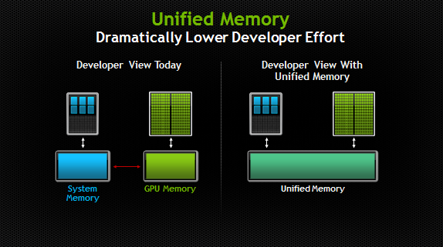
Unified memory introduced in CUDA 6
Image taken from : https://developer.nvidia.com/blog/unified-memory-in-cuda-6/
Notes:
So in this slide we would talk about the Unified memory which was introduced in CUDA 6. As you can see in the diagram below taken from nvidia the one on the left is what we see before unified memory is introduced. So before CUDA 6, the GPU and CPU memory are separated by the PCI-Express bus, and now on CUDA 6 on the right side of the diagram they introduced a pool of managed memory that can is shared by both GPU and CPU. The system automatically migrates data allocated in the Unified memory between host (GPU) and device (CPU) so that it looks like CPU/GPU are running its code to its respective memory.

Slide 4
Unified memory introduced in CUDA 6
cudaMallocManaged() is the new API used to allocate space to Unified Memory which is accessible to both the host and device.
Notes:
So we use unified memory by using the cudaMallocManaged() API. The API command allocates space to the Unified memory which is accessible to both the host and device.

Slide 5
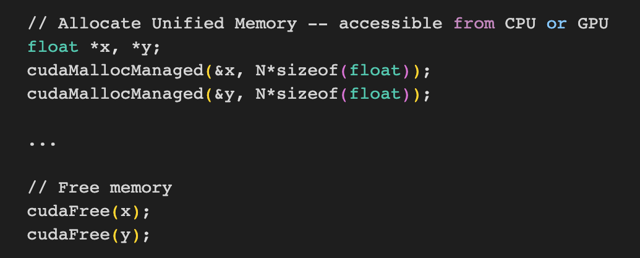
Unified Memory Implementation
Notes:
In this slide we can see how cudaMallocManaged is used in code. We can see that the parameters used is &x and &y which points to an address and the 2nd parameters is N (expected input size) times the size of the datatype of the address we pointed to in our case it is a float.

Slide 6
Prefetching of data with memory advice
Prefetching
A technology commonly supported in hardware on CPUs.
Fetching data before it is actually needed.
Data created on the host side and the device side needs the data.
cudaMemPrefetchAsynch(array_ptr, array_size, device, NULL)
Data is on the device side and host needs it.
cudaMemPrefetchAsynch(array_ptr, array_size, cudaCpuDeviceId, NULL)
Notes:
As we learned from the previous slides, Unified Memory uses cudaMallocManaged(), an allocation function that returns a pointer accessible from any processor. When code running on a CPU or GPU accesses data allocated this way, the CUDA system software and/or the hardware takes care of migrating memory pages to the memory of the accessing processor.
But during runtime, it doesn’t automatically copy all the pages back to the GPU before running the kernel. The kernel launches without any migration overhead, and when it accesses any absent pages, the GPU stalls the execution of the accessing threads, and the Page Migration Engine migrates the pages to the device before resuming the threads.
Most instructions must operate on data, and that data almost always originates in the device memory attached to the GPU. One of the main reasons why even the abundance of warps on an SM can run out of work is because they are waiting for data to arrive from memory.
If this happens, and the bandwidth to memory is not fully utilized, it may be possible to reorganize the program to improve memory access and reduce warp stalls, which in turn makes the program complete faster.
Prefetching
The CPU sees a stream of requests from memory arriving, figures out the pattern, and starts fetching data before it is actually needed. While that data travels to the execution units of the CPU, other instructions can be executed, effectively hiding the travel costs (memory latency).
If bullet 2. It is a better idea to prefetch the data before calling the kernel using bullet 3. Vice versa, when bullet 4. It can be prefetch back to the host using bullet 5.

Slide 7
Prefetching of data with memory advice
cudaMemAdvise can be used to advise the usage of a given memory.
The syntax is: cudaMemAdvise(array_ptr, array_size, advice, device)
cudaMemAdvise(in, ARRAY_BYTES, cudaMemAdviseSetPreferredLocation, cudaCpuDeviceId);
Array in is usually in the host side.
cudaMemAdvise(in, ARRAY_BYTES, cudaMemAdviseSetReadMostly, device);
Array in is usually read-only
Notes:
Now that we know what is prefetching, we could now proceed with discussing memory advise. Which could improve the memory transfer time by reducing the transfer of data between CPU and GPU.
Parameters
devPtr - Pointer to memory to set the advice for
Count - Size in bytes of the memory range
Advice - Advice to be applied for the specified memory range
Device - Device to apply the advice for
cudaMemAdviseSetPreferredLocation: This advice sets the preferred location for the data to be the memory belonging to device. Passing in cudaCpuDeviceId for device sets the preferred location as host memory. If device is a GPU, then it must have a non-zero value for the device attribute cudaDevAttrConcurrentManagedAccess. Setting the preferred location does not cause data to migrate to that location immediately. Instead, it guides the migration policy when a fault occurs on that memory region. If the data is already in its preferred location and the faulting processor can establish a mapping without requiring the data to be migrated, then data migration will be avoided. On the other hand, if the data is not in its preferred location or if a direct mapping cannot be established, then it will be migrated to the processor accessing it.
cudaMemAdviseSetReadMostly: This implies that the data is mostly going to be read from and only occasionally written to.
cudaMemAdviseSetAccessedBy: This advice implies that the data will be accessed by device.

Slide 8
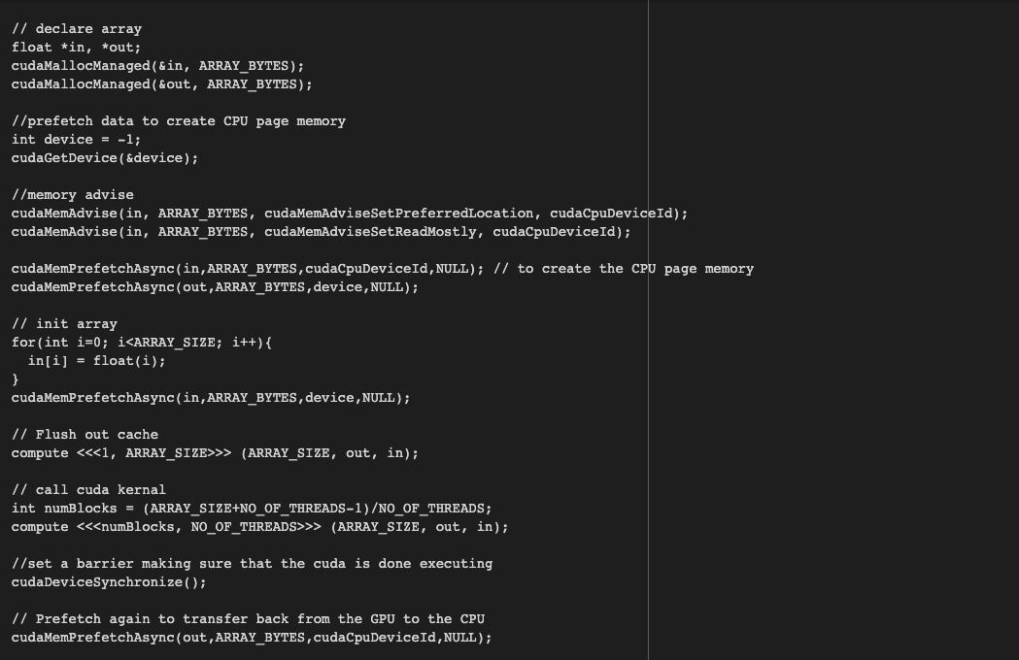
Prefetching of Data with MemAdvice Implementation

Slide 9
Data transfer or initialization as a CUDA kernel
Kernels are defined by the keyword __global__ declaration which specifies that the functions called will execute on device (GPU) and call from (CPU) code.
<<<numBlock, numThread>>> is used to call kernel to do specific functions/methods using the specified number of blocks and number of threads. Each thread in that executes the kernel are given a unique threadID (ThreadIdx.x)
Notes:
Kernels are defined by the keyword __global__ declaration which specifies that the functions called will execute on device (GPU) and call from (CPU) code.
<<<numBlock, numThread>>> is used to call kernel to do specific functions/methods using the specified number of blocks and number of threads. Each thread in that executes the kernel are given a unique threadID (ThreadIdx.x)

Slide 10
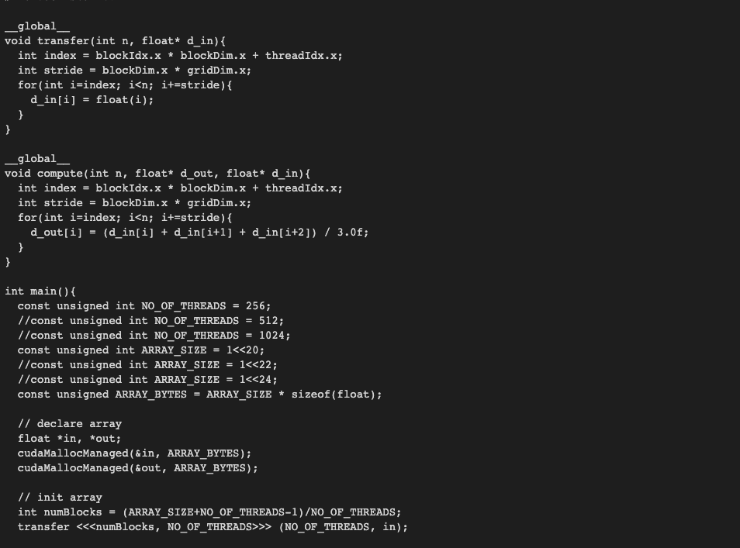
Data transfer/ initialization as a CUDA Kernel Implementation
Notes:
So in this slide we can see how multiple kernels are defined one of them is the kernel transfer, this initializes the value of the array to an increasing value depending on the stride value. The other kernel we have is the compute kernel which does the equation out[i] = (in[i] + in[i+1] + in[i+2])/3.0f;

Slide 11
Old method of transferring data between CPU and memory (memCUDA copy)
Before cudaMallocManaged, there was the Unified Virtual Address (UVA).
cudaMemcpy - Copies data between host and device. (Synchronously)
cudaMemcpyAsync - Copies data between host and device. (Asynchronously)
Notes:
CUDA has supported Unified Virtual Addressing (UVA) since CUDA 4, and while Unified Memory depends on UVA, they are not the same thing. UVA provides a single virtual memory address space for all memory in the system, and enables pointers to be accessed from GPU code no matter where in the system they reside, whether its device memory (on the same or a different GPU), host memory, or on-chip shared memory. It also allows cudaMemcpy to be used without specifying where exactly the input and output parameters reside. UVA enables “Zero-Copy” memory, which is pinned host memory accessible by device code directly, over PCI-Express, without a memcpy. Zero-Copy provides some of the convenience of Unified Memory, but none of the performance, because it is always accessed with PCI-Express’s low bandwidth and high latency.
UVA does not automatically migrate data from one physical location to another, like Unified Memory does. Because Unified Memory is able to automatically migrate data at the level of individual pages between host and device memory, it required significant engineering to build, since it requires new functionality in the CUDA runtime, the device driver, and even in the OS kernel. The following examples aim to give you a taste of what this enables.
Parameters
Dst - Destination memory address
Src - Source memory address
Count - Size in bytes to copy
Kind - Type of transfer
Copies count bytes from the memory area pointed to by src to the memory area pointed to by dst, where kind specifies the direction of the copy, and must be one of cudaMemcpyHostToHost, cudaMemcpyHostToDevice, cudaMemcpyDeviceToHost, cudaMemcpyDeviceToDevice, or cudaMemcpyDefault. Passing cudaMemcpyDefault is recommended, in which case the type of transfer is inferred from the pointer values. However, cudaMemcpyDefault is only allowed on systems that support unified virtual addressing.
An important point is that a carefully tuned CUDA program that uses streams and cudaMemcpyAsync to efficiently overlap execution with data transfers may very well perform better than a CUDA program that only uses Unified Memory. Understandably so: the CUDA runtime never has as much information as the programmer does about where data is needed and when! CUDA programmers still have access to explicit device memory allocation and asynchronous memory copies to optimize data management and CPU-GPU concurrency. Unified Memory is first and foremost a productivity feature that provides a smoother on-ramp to parallel computing, without taking away any of CUDA’s features for power users.

Slide 12
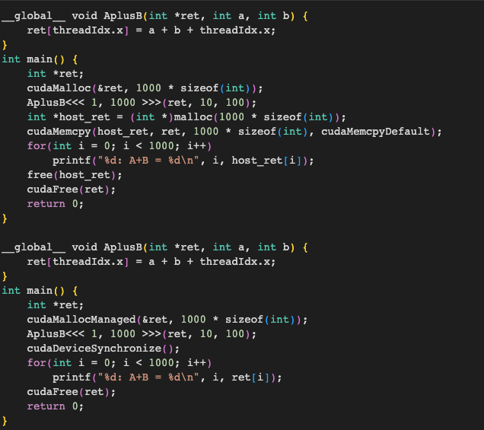
Old method of transferring data between CPU and memory (memCUDA copy)
Notes:
This first example combines two numbers together on the GPU with a per-thread ID and returns the values in an array. Without managed memory, both host- and device-side storage for the return values is required (host_ret and ret in the example), as is an explicit copy between the two using cudaMemcpy().
Compare this with the Unified Memory version of the program, which allows direct access of GPU data from the host. Notice the cudaMallocManaged() routine, which returns a pointer valid from both host and device code. This allows ret to be used without a separate host_ret copy, greatly simplifying and reducing the size of the program.

Slide 13
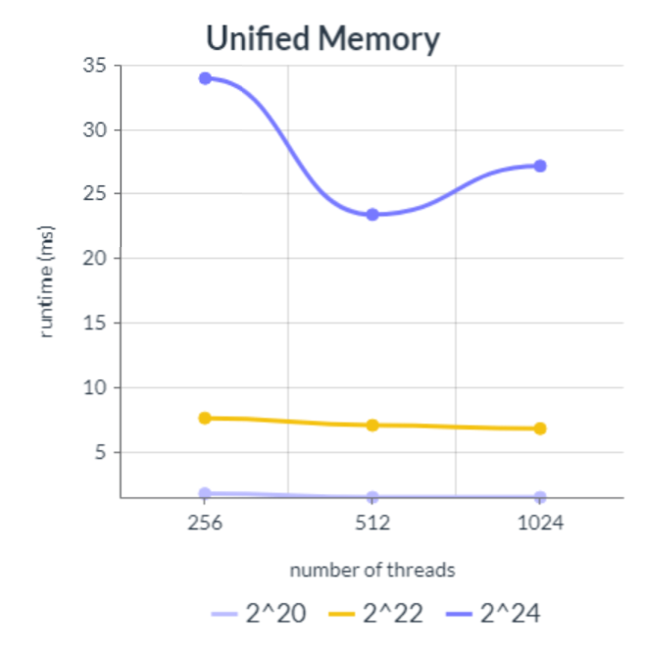
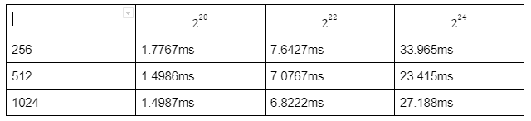
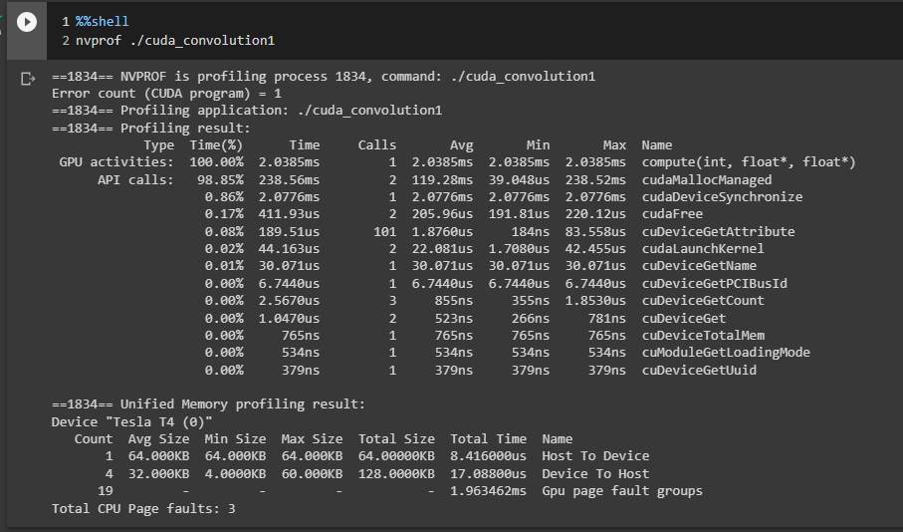
Analysis - Unified Memory
Notes:
In this slide we can see on the graphs/table the larger the number of threads the faster the execution time. Specially from 256 threads to 512 threads. The increase from 512 to 1024 though is not as significant as the first increase. As we can see the decrease in execution is not as drastic on the input size 2^20, but we see a significant decrease in the input size 2^22. However, there has been an increase in the execution time for the input size 2^24.We can also see that using unified memory alone we still have a total of 3 CPU Page faults.

Slide 14
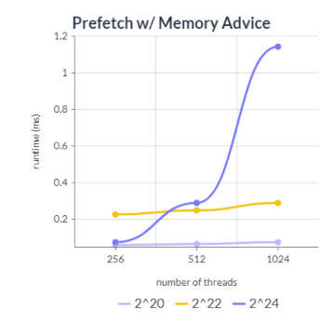
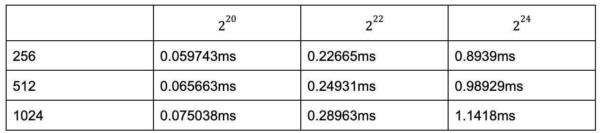
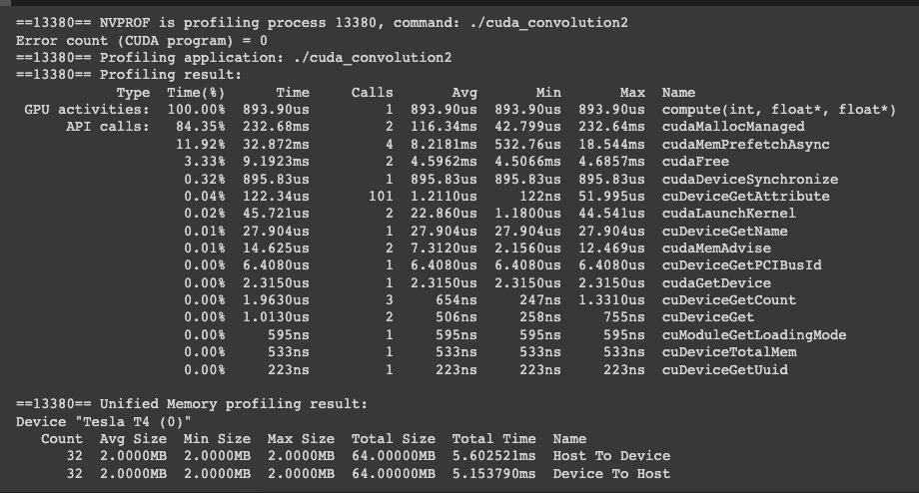
Analysis - Prefetching with Memory Advice

Slide 15
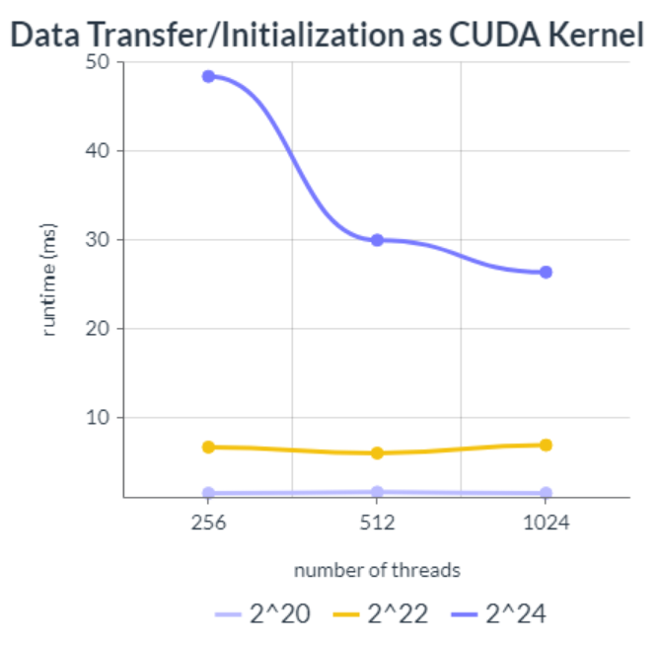
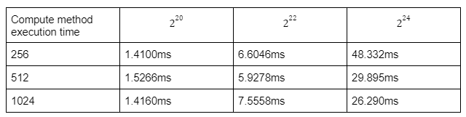
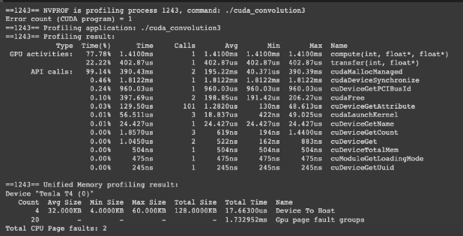
Analysis - Data transfer/initialization as a CUDA kernel
Notes:
In this slide we can see that using Data transfer/initialization as a CUDA kernel results to having 2 entries in the GPU activities 1 for the compute kernel and 1 for the transfer kernel. We can also see that there are still 2 page faults. At the input side of 2^20 we can see that as the number of threads increases the average execution time seem to almost be the same. However if we look at the input 2^24 we can see significant changes in the execution time as the number of threads increases.

Slide 16
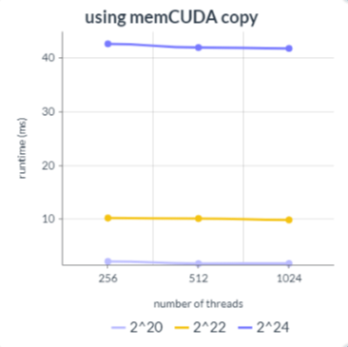
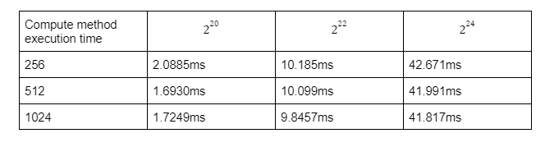
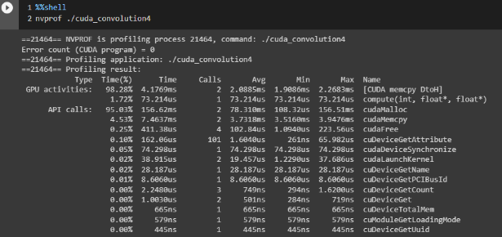
Analysis - memCUDA copy

Slide 17
References
https://developer.nvidia.com/blog/unified-memory-in-cuda-6/
https://docs.nvidia.com/cuda/cuda-c-programming-guide/index.html
https://developer.nvidia.com/blog/boosting-application-performance-with-gpu-memory-prefetching/
https://docs.nvidia.com/cuda/cuda-runtime-api/group__CUDART__MEMORY.html#group__CUDART__MEMORY_1ge37112fc1ac88d0f6bab7a945e48760a

